Slide 1

Patient centered Information Exchange System

Slide 2

Team members
1: Anushruti Singh
2: Bhuvna Chandrika
3: K.K Pavithra
4: Kavita Chaudhary

Slide 3
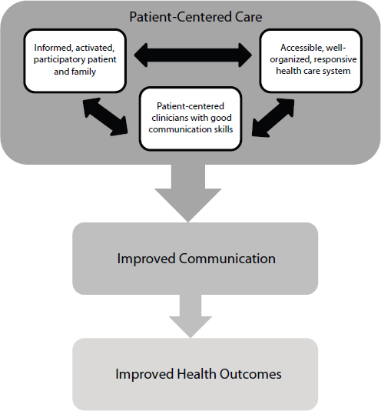
Problem Statement
Enabling a Patient – centered information exchange system
Block Diagram

Slide 4

What is Patient centered information system
Patient centered information systems augment traditional approaches to health information management with specific functions designed to support patient participation in health care decision making and treatment activities.
The system in which Doctor and Patient can equally contribute -
Doctor can view their profile
Patient information
His patient appointments and can add the
prescription to patients
Doctor

Slide 5

Patients
Patient can view their profile
Check doctors record
View their appointments
Check their prescribed prescriptions by their doctors
Can check the lab reports and download it respectively.

Slide 6

FRONT END

Slide 7
Requirement Specification
A computerized way of handling information about property and users details is efficient, organized, time saving compared to a manual way of doing so. This is done through a database driven web applications whose requirements are mentioned below :
1 : phpMyAdmin
2: XAMPP Server
3: Chrome
4: Any IDE

Slide 8

Programming languages
PHP : For backend and to communicate with MySQL.
HTML and CSS : For front end development.
Bootstrap : to design a web pages and to make them responsive.
Java script : to make it responsive and reactive.

Slide 9

Implementation
This will be implemented in HTML, CSS, Java script, and Bootstrap for front end development.
MySQL for back-end(database) development.
PHP communicate with localhost through XAMPP server.
XAMPP server communicate with HTML and PHP code that is then displayed in front end.
The server communicate with MySQL using PHPMyAdmin.

Slide 10
RESULT
The resulting system is able to :
Authenticate user credentials during login.
Register the information of doctor and patient to the hospital.
Allow patient to book the appointments.
Allow doctors to prescribe the prescription for patients.
Allow patient to check their prescriptions and appointment history.
Allow patient to check the lab reports.

Slide 11
Thank you

